Slide 1
Session 09 – Continuity
MIS 6311-501 Cyber Security Fundamentals
Chris Davis

Slide 2
Housekeeping
Any Questions? Please do not hesitate to email. Or text.
Class Website: https://elearning.utdallas.edu
Dropbox: https://goo.gl/9AFyoE
UTD Email: cmd140430@utdallas.edu
Gmail: davischr2@gmail.com
Google Voice: 214-771-8122 (Text & Emergencies)
LinkedIn: www.LinkedIn.com/in/ChristopherDavis
Blog: www.cloudauditcontrols.com
Class: Monday 7:00pm-9:45pm JSOM 12.210

Slide 3
Academic Calendar & Sessions

Slide 4
Comparison of Our Class to CISSP Domains
Shon Harris Book – Chapters
Current CISSP Domains
2
Information Security Governance and Risk Management
8
Business Continuity and Disaster Recovery Planning
Security and Risk Management
9
Legal, Regulations, Investigations and Compliance
7
Cryptography
Security Engineering
4
Security Architecture and Design
Security Assessment and Testing
5
Physical (Environmental) Security
Asset Security
6
Telecommunications and Network Security
Communications and Network Security
3
Access Control
Identity and Access Management
11
Operations Security
Security Operations
10
Software Development Security
Software Development Security

Slide 5
Tales from the Crypt.
Practical Applications & Lessons Learned.

Slide 6


Slide 7
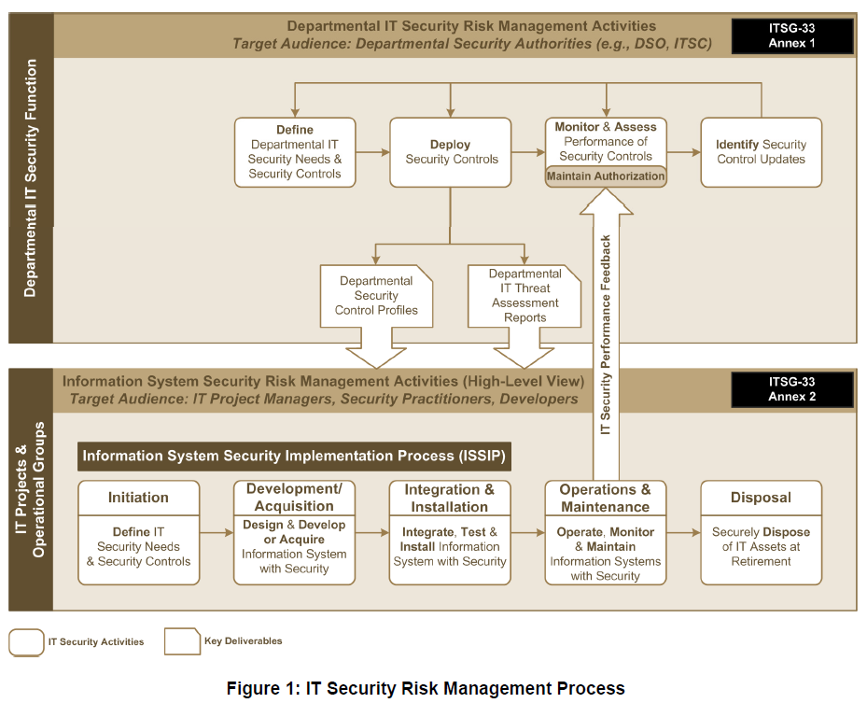
https://www.cse-cst.gc.ca/en/system/files/pdf_documents/itsg33-overview-apercu-eng_0.pdf

Slide 8
Let’s Get Started.

Slide 9
Session Contents
This chapter presents the following:
Business continuity management • Business continuity planning components • Standards and best practices • Selecting, developing, and implementing disaster and continuity solutions • Recovery and redundant technologies • Backup and offsite facilities • Types of drills and tests
Notes:
The architecture of a computer system is very important and comprises many topics. The system has to ensure that memory is properly segregated and protected , ensure that only authorized subjects access objects, ensure that untrusted processes cannot perform activities that would put other processes at risk, control the flow of information, and define a domain of resources for each subject. It also must ensure that if the computer experiences any type of disruption, it will not result in an insecure state. Many of these issues are dealt with in the system’s security policy , and the security model is built to support the requirements of this policy. Once the security policy, model, and architecture have been developed, the computer operating system, or product, must be built, tested, evaluated, and rated. An evaluation is done by comparing the system to predefined criteria. The rating assigned to the system depends upon how it fulfills the requirements of the criteria. Customers use this rating to understand what they are really buying and how much they can trust this new product. Once the customer buys the product, it must be tested within their own environment to make sure it meets their company’s needs, which takes place through certification and accreditation processes.
Harris, Shon (2012-11-08). CISSP All-in-One Exam Guide, 6th Edition (Kindle Locations 8633-8641). McGraw-Hill Education. Kindle Edition.
Security terminology and principles • Protection control types • Security frameworks, models, standards, and best practices • Security enterprise architecture • Risk management • Security documentation • Information classification and protection • Security awareness training • Security governance
Harris, Shon (2012-11-08). CISSP All-in-One Exam Guide, 6th Edition (Kindle Locations 1007-1011). McGraw-Hill Education. Kindle Edition.

Slide 10
Chris's View

Slide 11
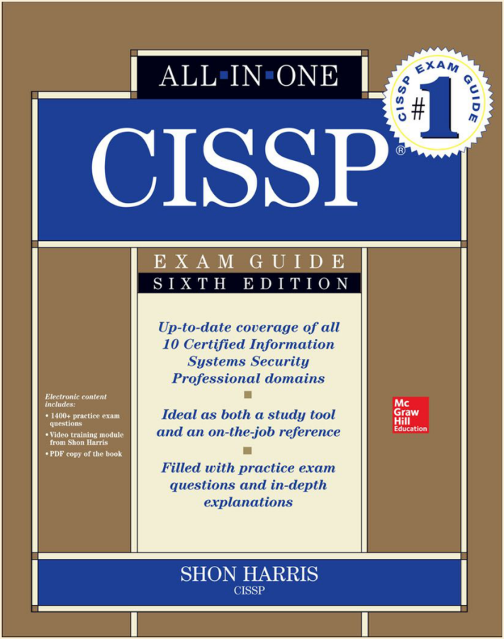
Today's Materials
Harris, Shon (2012-11-08).
CISSP All-in-One Exam Guide, 6th Edition.
McGraw-Hill Education.

Slide 12
Chapter 9: Business Continuity Planning and Disaster Recovery
Slides marked Brian E. Brzezicki in the bottom left-hand corner were created and graciously provided by Brian Brzezicki. These are materials he created for his own classes.
Brian E. Brzezicki

Slide 13
BCP and DR
An organization is dependant on resources, personnel and tasks performed on a daily bases to be healthy and profitable. Loss or disruption of these resources can be detrimental. Causing great damage or even complete destruction of the business.
Business MUST have a plan to deal with unforeseen events.
Brian E. Brzezicki

Slide 14
BCP and DR
Business Continuity Planning is a broad approach to ensure that a business can function in the event of disruption of normal data processing operations.
Disaster Recovery Planning is a subset of BCP. The goal of a DRP is to minimize the effects of a disaster and take necessary steps to ensure that the resources, personnel and business processes are able to resume operation in a timely manner.
Brian E. Brzezicki

Slide 15
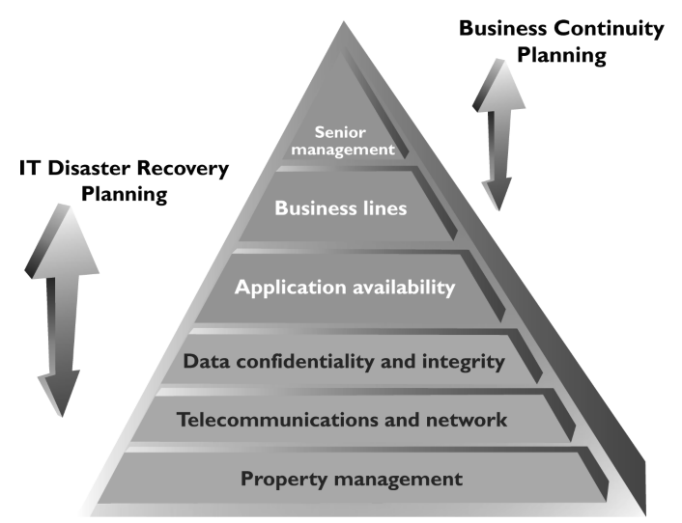
BCP vs. DRP

Slide 16
Terms for This Chapter
Business Continuity Planning – Planning to help organizations identify the impacts of potential data processing and operation disruptions and data loss, formulate recovery plans to ensure the availability of data processing and operational resources.
(more)
Brian E. Brzezicki

Slide 17
Terms
Business Impact Analysis – Process of analyzing all business functions within the organization to determine the impact of a data processing outage.
Business Resumption Planning – BRP develops procedures to initiate the recovery of business operations immediately following and outage or disaster.
(more)
Brian E. Brzezicki

Slide 18
Terms
Critical Business Functions – The business functions and processes that MUST be restored immediately to ensure the organizations assets are protected, goals met and that the organization is in compliance with any regulations and legal responsibilities.
Critical System – The hardware and software necessary to ensure the viability of a business unit or organization during an interruption in normal data processing support.
(more)
Brian E. Brzezicki

Slide 19
Terms
Disaster Recovery Plan – A plan that provides detailed procedures to facilitate recovery of capabilities at an alternate site.
Brian E. Brzezicki

Slide 20
Objectives of the BCP
By doing BCP planning and DR planning an organization attempts to
Understand the risks to it’s ability to function continually.
Ensure survivability of the business
Reduce business impact of disasters
Provide an immediate response to emergency situations
Resume critical business functions ASAP after a disaster
Protect lives and ensure safety*
Reduce confusion during a crisis
Brian E. Brzezicki

Slide 21
Business Continuity Planning
Brian E. Brzezicki

Slide 22
BCP Overview
The goal of a BCP is ultimately to ensure the continued operation of business functionality in the event of a damaging event.
The BCP is really part of the larger security program. As such a BCP should be part of the security policy*
Brian E. Brzezicki

Slide 23
Steps in BCP (overview)
ISC states 7 Phases in BCP. We will outline them now, and detail them later.
Project Initialization – establish a project team and obtain management support
Conduct BIA – identify time-critical business processed and determine maximum “outages”
Identify Preventative controls
Recovery Strategy – identify and select the appropriate recovery alternatives to meet the recovery time requirements.
(more)
Brian E. Brzezicki

Slide 24
Creating the BCP (overview)
Develop the contingency plan – document the results of the BIA findings and recovery strategies in a written plan
Testing, Awareness, and Training – establish the processes for testing the recovery strategies, maintaining the BCP, and ensuring that those involved are aware and trained in the recovery strategies.
Maintenance – Maintain the plan
Brian E. Brzezicki

Slide 25
Business Continuity Planning The 7 Steps expanded
Brian E. Brzezicki

Slide 26
BCP the 7 Step
Beware, as these steps go into detail and often contain sub steps… things are going to get confusing.
Brian E. Brzezicki

Slide 27
BCP Phase 1 Project Initialization

Slide 28
BCP: Phase 1 Project Initialization
Project Management and Initialization:
Solidify management support
Without management support, it’s guaranteed to fail
Develop a Continuity Planning Policy Statement
lays out the scope of the BCP project, roles and members, and goals.
(more)
Brian E. Brzezicki

Slide 29
BCP: Phase 1 Project Initialization
Identify a Business Continuity Coordinator*
the BCP team leader
Establish a BCP team
What types of people/roles should be on the team (pg 784)* (should expand out on actual slide)
Brian E. Brzezicki

Slide 30
BCP Phase 2: BIA

Slide 31
BCP Phase 2: BIA
The organization must do a Business Impact Analysis as stage 2.
Ultimately want to determine the important business processes.
Determine cost (qualitative or quantitative) that a loss of these processes will cost
Determine Maximum Tolerable Downtime (MTD) for these processes*.
Brian E. Brzezicki

Slide 32
BCP Phase 2: BIA
Here are some common MTD classifications*
Critical: 1 – 4 hours
Urgent: 24 hours
Important: 72 hours
Normal: 7 days
Nonessential: 30 days
Brian E. Brzezicki

Slide 33
BCP Phase 2: BIA
Keep in mind when prioritizing things, use both quantitative and qualitative analysis to determine what is critical.
Example:
Loss of some process might not cause immediate financial loss, but could damage reputation or competitive advantage, that damage could be devastating.
Brian E. Brzezicki

Slide 34
BCP Phase : BIA
Once the research is done and organization must document and present the findings to management.
Note at this point there is not a Business Continuity Plan yet, just research.
Once Management reviews findings and gives the OK to proceed the plan will start to be developed.
Brian E. Brzezicki

Slide 35
BCP Phase 3: : Identify Preventative Controls

Slide 36
BCP Phase 3: : Identify Preventative Controls
Once critical business processes and associated MTDs have been determined. Analysis must be done to identify the specific resources that each process relies upon and the vulnerabilities and threats to these resources and choose cost effective preventative countermeasures.
This is risk management as described in chapter 3
The idea is to find ways to prevent the problems from occurring in the first place.
Brian E. Brzezicki

Slide 37
BCP Phase 4: Recovery Strategies

Slide 38
BCP Phase 4: Recovery Strategies
At this stage a plan for recovering in case of disaster starts coming into existence.
Up to now it was just research and analysis and obtaining management support.
We determined preventative controls
Now we are going to look at recovery
Brian E. Brzezicki

Slide 39
BCP Phase 4: Recovery Strategies
This is a more technical and tangible stage. The idea is to figure out what the company actually needs to do to be able to recover the necessary business processes in the event of a catastrophe.
Goals of this stage are:
Determine the most cost-effective* recovery mechanisms
Formally define the activities and actions that will be implemented and carried out in response to a disaster.
These strategies will be based on the 5 main business recovery strategies listed on the next page
Brian E. Brzezicki

Slide 40
Phase 4: Recovery Strategies
5 categories
Business Process Recovery
Facility Recovery
Supply and Technology Recovery
User Environment Recovery
Data Recovery
We will go into more detail on each of these categories coming up.
Brian E. Brzezicki

Slide 41
Business Process Recovery
A Business Process is a set of interrelated steps linked through specific actives to accomplish a specific task. For these processes the team must know the components of the process including
Required roles
Required resources
Input and output mechanisms
Workflow steps
Required time for completions
Interdependencies between this processes and other processes.
Brian E. Brzezicki

Slide 42
Facility Recovery
Facility Recovery is concerned with the ability to move processing operations to an alternate facility in case of the failure of the main facility. We can have multiple method to deal with this including
subscriptions services with service bureaus*
Reciprocal Agreements*
Redundant Sites*
Lets looks into each of these more
Brian E. Brzezicki

Slide 43
Facility Recovery Subscription services
A subscription service is a contract with a 3rd party to provide access to a facility. There is generally a monthly fee to retain the right to use the facility along with a large activation fee and hourly fee when actually using the facility. This is obviously a short term only solution. There are 3 types of subscription services which we will talk about more of in the next slides
Hot Site
Warm Site
Cold Site
Brian E. Brzezicki

Slide 44
Alternate Sites
You need to understand the different types of alternate sites discussed on the next few slides as well as the terminology, characteristics, pros and cons of each. The exam explores these topics heavily.
Brian E. Brzezicki

Slide 45
Hot Site
Hot Site – a facility that is fully configured and ready to operate in a few hours. The only resources missing from a hot site is the actual data and the actual employees.
Hardware and software MUST be fully compatible or it’s pointless
Vendor may not have customer specific or proprietary hardware/software
+ can allow for annual testing
+ ready within hours
- Very Expensive
Brian E. Brzezicki

Slide 46
Warm Site
A facility that is usually partially configured with some computing equipment, but not significant hardware. i.e. a hot site without the expensive stuff.
Generally can be up in an acceptable time period.
May be better for customers with specific hardware/software needs, customer will bring computing hardware with them.
Most widely used model
+cheaper
+available for longer timeframe due to reduced costs
+ good if you have our own custom hardware/software
- takes longer to prepare
-actual yearly testing not generally possible
Brian E. Brzezicki

Slide 47
Cold Site
Supplies basic environment, (AC, electrical, plumbing etc), but NO actual computing equipment. Can take a while to activate.
+cheaper
+available for longer timeframe due to reduced costs
+ good if you have our own custom hardware/software
- May take weeks to get activated and ready
- Cannot do yearly tests
Brian E. Brzezicki

Slide 48
Reciprocal Agreement
RA also called Mutual Aid is when two companies agree to help each other out in the case of an emergency. Ultimately this is not really practical for most business.
What are the Pros and Cons of mutual aid are?
Why is mutual aid ultimately unreliable and impractical?
Brian E. Brzezicki

Slide 49
Redundant Sites
Organizationally owned mirror sites. This also may have live or slightly delayed data backups and some staff.
Literally mirrors the original site
Data available at mirror site.
+ best solution if turn around time and ability to recover all processing aspects are required
- VERY EXPENSIVE (duplicate costs except for personnel)
Brian E. Brzezicki

Slide 50
Multiple Processing Centers
Different model then mirror site -
Rather than live/mirror site. Normal business practice is to split the work among multiple active centers such that there is no single point of failure.
Solid approach
Good Scalability for normal business growth
Make sure that the other centers have more resources then they individually need in case they need to take on more work, due to the failure of another center.*
Brian E. Brzezicki

Slide 51
Supply and Technology Recovery
With alternate sites, the organization plans to recover it’s facilities and it’s main processing requirements from a overhead view. But what about the operational details.
Hardware Backups
Software Backups
Documentation
Human Resources
These considerations need to be taken into account also and will be discussed.
Brian E. Brzezicki

Slide 52
Hardware backups
When using an alternate site an organization has a space to process, but unless using a a hot site or redundant site and already has the necessary equipment.
Where does it get the replacement servers from.
What about the desktops that the staff needs?
Does the organization have vendors to provide these in a timely manner?
How long will it take to get new equipment from the vendor?
What happens if the equipment is legacy equipment.
These concerns need to be addressed before hand.
Brian E. Brzezicki

Slide 53
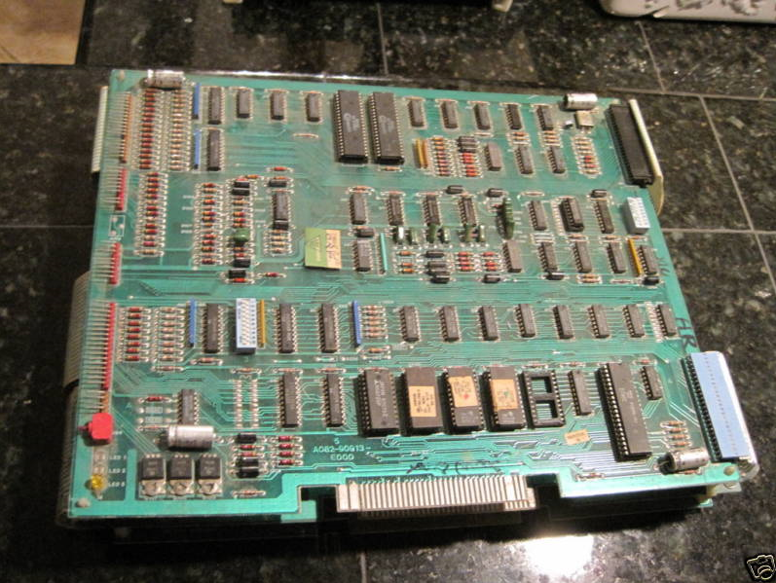
Legacy Equipment
Brian E. Brzezicki

Slide 54
Spare Equipment
Brian E. Brzezicki

Slide 55
Software Backups
Similar concerns about hardware backups but regarding software:
How do we get copies of the software.
how to we roll out installs.
What about licensing?
What about custom software that we had created that we cannot just go out and buy at the store?
Software escrow*
Brian E. Brzezicki

Slide 56
Data and System Backups
We are actually going to discuss backup strategies later.
Brian E. Brzezicki

Slide 57
Documentation
A company can plan for procuring sites, hardware and software but then:
how does a companyt get the servers and networks all rolled out and configured such they operate the same as before?
Incorrect configurations could cause compromises in integrity or confidentiality*! (how?)
Does the organization even know how it’s old network was configured? Can it reproduce it?
An Important concept for BCP that should be in company policy is that ‘All documentation should be kept-up to date and properly protected’
Brian E. Brzezicki

Slide 58
Documentation
A very important concept for BCP is that:
Company policy should require that ‘All documentation should be kept-up to date and properly protected’
Brian E. Brzezicki

Slide 59
Human Resources
What happens if the alternate site is 250 miles away?
How do the employees get to the alternate site?
What happens if the disaster was a natural catastrophe and some important employees are injured or worse.
Executive Succession Planning – what is this?
Brian E. Brzezicki

Slide 60
End User Environment
Concerns dealing with end users or employees.
How do we notify the users about a disaster and the change of operating procedure?
Once there we need to have some type of people on the ground directing issues pertaining to employees. These people should be easily identified.*
There must be ways to manually do tasks that may be previously automated, but resources no longer exist to automate.
The BCP team needs to consider these types of issues.
Brian E. Brzezicki

Slide 61
Phase 4: Restoration Strategies
Now that we covered recovery strategies we need to look at a couple of recovery concepts that we will need to understand in the planning stage.
Brian E. Brzezicki

Slide 62
Phase 4: Restoration
When planning it must be recognized that there are 3 different teams in DR.
Damage Assessment team
Restoration team
Salvage team
Lets look at these in the next slides
Brian E. Brzezicki

Slide 63
Phase 4: Restoration
Damage Assessment Team’s purpose and goals:
Assess the damage.*
Determine cause of disaster
Determine potential for further damage
Identify affected business functions and assets*
Indentify resources that must be replaced immediately
Estimate how long it will take to bring critical functions* online
Determine whether the BCP should be put into operation*
Brian E. Brzezicki

Slide 64
Phase 4: Recovery
Restoration Team – should be responsible for getting the alternate site into a working and functioning environment so business continuity is ensured.
Brian E. Brzezicki

Slide 65
Phase 4: Recovery
Salvage Team – responsible for starting the processes of recovering the original site and moving back from the backup site. *
The least critical functions should be moved first.*
When moving things back to the original site the most critical functions should be moved last*
Brian E. Brzezicki

Slide 66
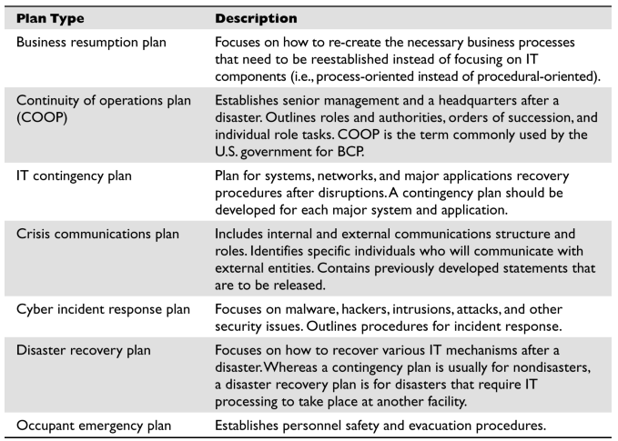
Different Types of Recovery Plans
Notes:
Different Types of Recovery Plans
Harris, Shon (2012-11-08). CISSP All-in-One Exam Guide, 6th Edition (Kindle Location 18724). McGraw-Hill Education. Kindle Edition.

Slide 67
BCP Phase 5: Develop the contingency plan

Slide 68
Phase 5: Plan design and development
Now the organization needs to actually come up with a goals and a plan for attaining these goals. These plans must contain certain key information.
Responsibility – who are the individuals responsible for what. What is expected of them, how will they be trained
Authority – in times of crisis who is in charge.
Priorities – What are the critical processes, what are the priorities.
Implementation and Testing – how will we implement our plans, how will it be tested.
Brian E. Brzezicki

Slide 69
Phase 5: Plan Design and Development
Strategies/concerns for the plan
Copies of the plan need to be kept in one or more locations. (why)
Plans must be in paper and electronic format
Call tress should be implemented
Brian E. Brzezicki

Slide 70
BCP: Phase 6 – Testing

Slide 71
BCP: Phase 6 – Testing
Once the plan is developed we need to have assurance that the plan and strategies will work, the plan needs to be tested.
Testing it also allows us to see where the plan can be improved, or if new changes in environment will require the plan to be updated (what company doesn’t change and grow?)
Testing should be carried out at LEAST once a year.*
Any problems that occurred should be documented and reported to management.*
Overview of testing methods on upcoming slides.
Brian E. Brzezicki

Slide 72
Checklist Test
BCP is distributed to departments and functional areas for review. The managers read over and indicate if anything is missing or should be modified. (manager “checks off” that the plan is OK for their department)
Brian E. Brzezicki

Slide 73
Structured Walk-Through
Representatives from each department come together AS A GROUP, they walk through the plan and different scenarios from beginning to end to make sure nothing is left out.
Brian E. Brzezicki

Slide 74
Simulation Test
A specific scenario is proposed, all required employees come together and start to simulate that the event has happened and start taking action to recover. The idea is to see if any problems come up or if any concerns were left out.
Brian E. Brzezicki

Slide 75
Parallel Test
Some systems are moved to the alternate site and processing takes place. The results are compared to the real processing to see if anything needs to change.
Brian E. Brzezicki

Slide 76
Full Interruption test
The original site is shutdown and processing is moved to the alternate site .The recovery team fulfils it’s obligation in preparing the systems and environment for the alternate site.
Most intrusive, it is a full blown drill.
Requires a hot, mirror or redundant site.
Requires massive planning and co-ordination
It is a risky test and can cause damage if not managed properly*
Senior management approval is required due to the risks involved*
Brian E. Brzezicki

Slide 77
BCP Phase 7: Maintaining the Plan

Slide 78
Phase 7: Maintaining the Plan
Now that the plan it tested and verified. It needs to be maintained!
Systems and processes become out of date and need constant refrest.
BCP plan may not be integrated into change management process (it should be)*
Infrastructure or environment changes*
Company re-organization or growth
Changes in hardware or software
Employee turn over
Brian E. Brzezicki

Slide 79
Phase 7: Maintaining the Plan
Strategies to keep the plan maintained and valid.
Make BCP planning part of every business decision!
Insert BCP maintenance responsibilities into job descriptions
Include maintenance in personnel evaluations
Perform internal audits that include DR and BCP procedures
Test the plan yearly*
Brian E. Brzezicki

Slide 80
Backups
Brian E. Brzezicki

Slide 81
Backups… RPO vs. RTO
Differences: Think about the recovery results….
RPO
RTO
EVENT
Data Lost
Recovery
Monday
Tuesday
Wednesday
Thursday…

Slide 82
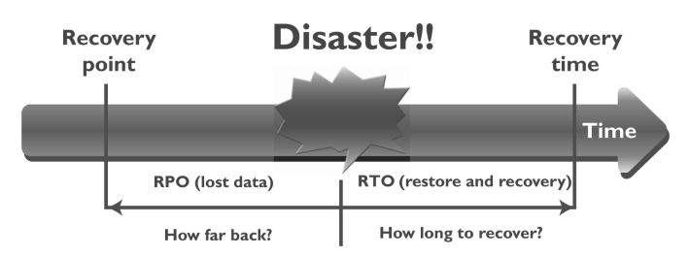
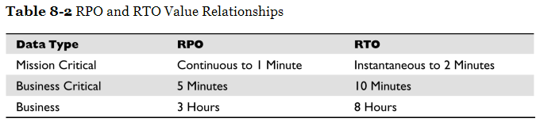
RPO vs. RTO

Slide 83
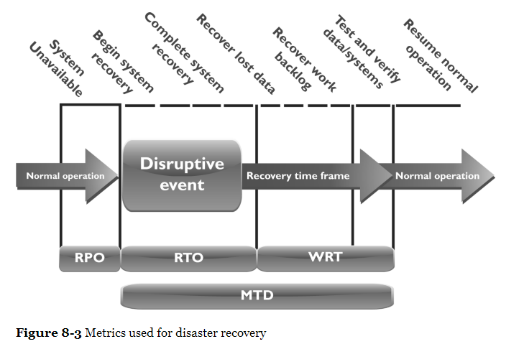
Metrics Used for Disaster Recovery

Slide 84
Backup Issues
Challenges to consider include:
Slow data transfer of backup
Globalization
Server disk space increases over time
Lost data between backup and when server goes down... Not recoverable from backups

Slide 85
Electronic Vaulting and Remote Journaling
Brian E. Brzezicki

Slide 86
Electronic Vaulting
Electronic Vaulting* is the idea of sending all changes to a file to a remote site (using non-backup methods). This usually done in batches and not real time.
Example:
bank transactions might be copied daily to another office
Brian E. Brzezicki

Slide 87
Remote Journaling
RJ is the same concept as a continuous backup to a remote facility. It is different than EV.
It is done in real-time
Entire files are not copied, only changes (deltas) to files.
also called transaction logs
From the base files and the transaction logs you can recreate the current environment.
Brian E. Brzezicki

Slide 88
Tape Vaulting
A type of backup, however rather than backing up to a local device you back up to a remote device.
Brian E. Brzezicki

Slide 89
Additional Concepts

Slide 90
Additional Key Terms

Slide 91
Final Thoughts

Slide 92
Final Thoughts
Disaster recovery and continuity planning should be brought into normal business decision-making procedures.
The loss criteria for disasters include much more than direct dollar loss. They may include added operational costs, loss in reputation and public confidence, loss of competitive advantage , violation of regulatory or legal requirements, loss in productivity, delayed income, interest costs, and loss in revenue.
A survey should be developed and given to the most knowledgeable people within the company to obtain the most realistic information pertaining to a company’s risk and recovery procedures.
The plan’s scope can be determined by geographical, organizational , or functional means.

Slide 93
Final Thoughts
Many things need to be understood about the working environment so it can be replicated at an alternate site after a disaster.
Offsite backup locations can supply hot, warm, or cold sites.
A reciprocal agreement is one in which a company promises another company it can move in and share space if it experiences a disaster, and vice versa. Reciprocal agreements are very tricky to implement and are unenforceable. However , they are cheap and sometimes the only choice.
A hot site is fully configured with hardware, software, and environmental needs. It can usually be up and running in a matter of hours. It is the most expensive option, but some companies cannot be out of business longer than a day without very detrimental results.

Slide 94
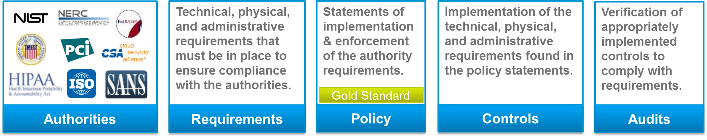
From Authorities to Audits
PCI-DSS Example
Authority: PCI-DSS is the authority document created by the PCI-SSC.
Requirement: (10.6) Review logs for all system components at least daily.
Policy: Monitoring Policy – States logs will be reviewed at least daily.
Control: Tool XYZ provides real-time monitoring for all system components.
Audit: Auditor verifies Tool XYZ is appropriately monitoring and alerting to actionable events. Audit results and evidence are stored as part of the audit.

Slide 95
Effectively Managed IT Controls
Technology can affect every part of the business.
At its best, technology is a competitive advantage.
At its worst, technology is your competitor’s advantage.
Product
Market Relationships
IT Controls:
Detective, protective and reactive measures in place to protect the confidentiality, integrity, and availability of business information and ensure appropriate management of the IT function to meet business objectives.
Inbound Logistics
Operations
Outbound Logistics
Marketing
and Sales
Service
Firm Infrastructure
HR Management
Margin
Procurement
Technology Development
Notes:
Compliance Control: A process, effected by management and other personnel, designed to provide reasonable assurance that transactions are executed in accordance with 1) laws governing the use of budget authority and other laws and regulations that could have a direct and material effect on the financial statements or required supplementary stewardship information and 2) any other laws, regulations, and government wide policies identified in OMB audit guidance. [GAO/PCIE Financial Audit Manual]
Source: http://www.unifiedcompliance.com/it_compliance/language_compliance/definitions/c.html

Slide 96
Chris Davis
UTD Email: cmd140430@utdallas.edu
Google Voice: 214-771-8122
Course Materials
https://elearning.utdallas.edu

Slide 97
Additional Materials

